Slide 1
SentenceZing Funding Proposal
Brian Highnam | Roberto Isidro
Michael Watkinson

Slide 2
Agenda
Kickstarter
Google Adsense
YouTube

Slide 3

Kickstarter

Slide 4
Kickstarter Overview
Unique way of funding creative projects
Project end date
Establish time within which to collect funding
Kickstarter funding:
All-or-nothing funding model
Incremental donation amounts
Notes:
Explain about kickstarter, how are we going to use it
The YouTube videos will just show us via camtasia , FRAPS ,etc. explain the different cool features of sentencezing

Slide 5
Kickstarter Initial Setup
Written and Video Explanations
Description of project
Main goals and stretch goals
Explanation of work
Updates
Funding Justification

Slide 6
Using Kickstarter
Connecting to Kickstarter funders
Youtube - post updates and interesting videos
Facebook - grow SZ page and keep updated
Twitter - force ourselves to use
Twitch - Way to advertise and show off site
Friends and family - Early adopters

Slide 7
Using Kickstarter (cont)
Reward packages for funders
Ex: Free e-books of stories, SZ T-shirts, Badges for profile, or Skype sessions with developers
Organized events
Ex: Story competitions with prizes for the highest voted stories.

Slide 8
Kickstarter Case Studies
How to write description, rewards, and stretch goals.
Promote why the project idea is so unique.
What skills/services are required and how funding would be spent
Chaos Hour
Very visually appealing
Clearly sets its goals and rewards
Eat Your Serial
Website showing readers short chapters of books.
Good comparison for how to describe and promote Sentencezing
https://www.kickstarter.com/projects/padraig-balch/chaos-hour-website-development-and-entertainment-p?ref=search
https://www.kickstarter.com/projects/592377631/eat-your-serial-a-new-website-connecting-writers-a?ref=search

Slide 9

Roberto

Slide 10
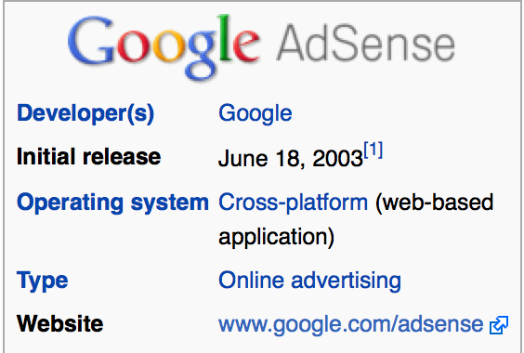

Slide 11
Google AdSense
Run and administered by Google,Inc.
Uses Internet Search tech to serve advertisements based on website content.
Can generate revenue ( per-click or per-impression).
Roberto

Slide 12
Google AdSense (cont.)
Plan to get funding
Really simple signup process
Designate a space on website for ads
Google will designate your space.
Get paid.
Roberto

Slide 13

Google AdSense (cont.)
Process
Roberto

Slide 14
Google AdSense (cont.)
so...why Google AdSense?
Two million publishers can’t be wrong.
Access to more advertisers
Robust targeting
Reporting tools
Roberto

Slide 15

YouTube

Slide 16

Found help on YouTube
Found 9 tips for marketing on YouTube
Partner with YouTube Celebrities
Have your videos link back to you Site
Upload new videos frequently
Have customer feedback videos
Notes:
Here are some of the best of 9 tips on how to utilize YouTube to its full potential

Slide 17
Successful YouTubers
Successful YouTuber → thenewboston
thenewboston
Founder = Bucky Roberts
Creates programming tutorials( e.g. Java )
Has 694,758 subscribers
Just started by posting few videos

Slide 18
Our YouTube Approach
Utilize the 9 tips
Create channel and upload few videos
Post on our Facebook page created videos
Our hope → share our page

